Slide 1
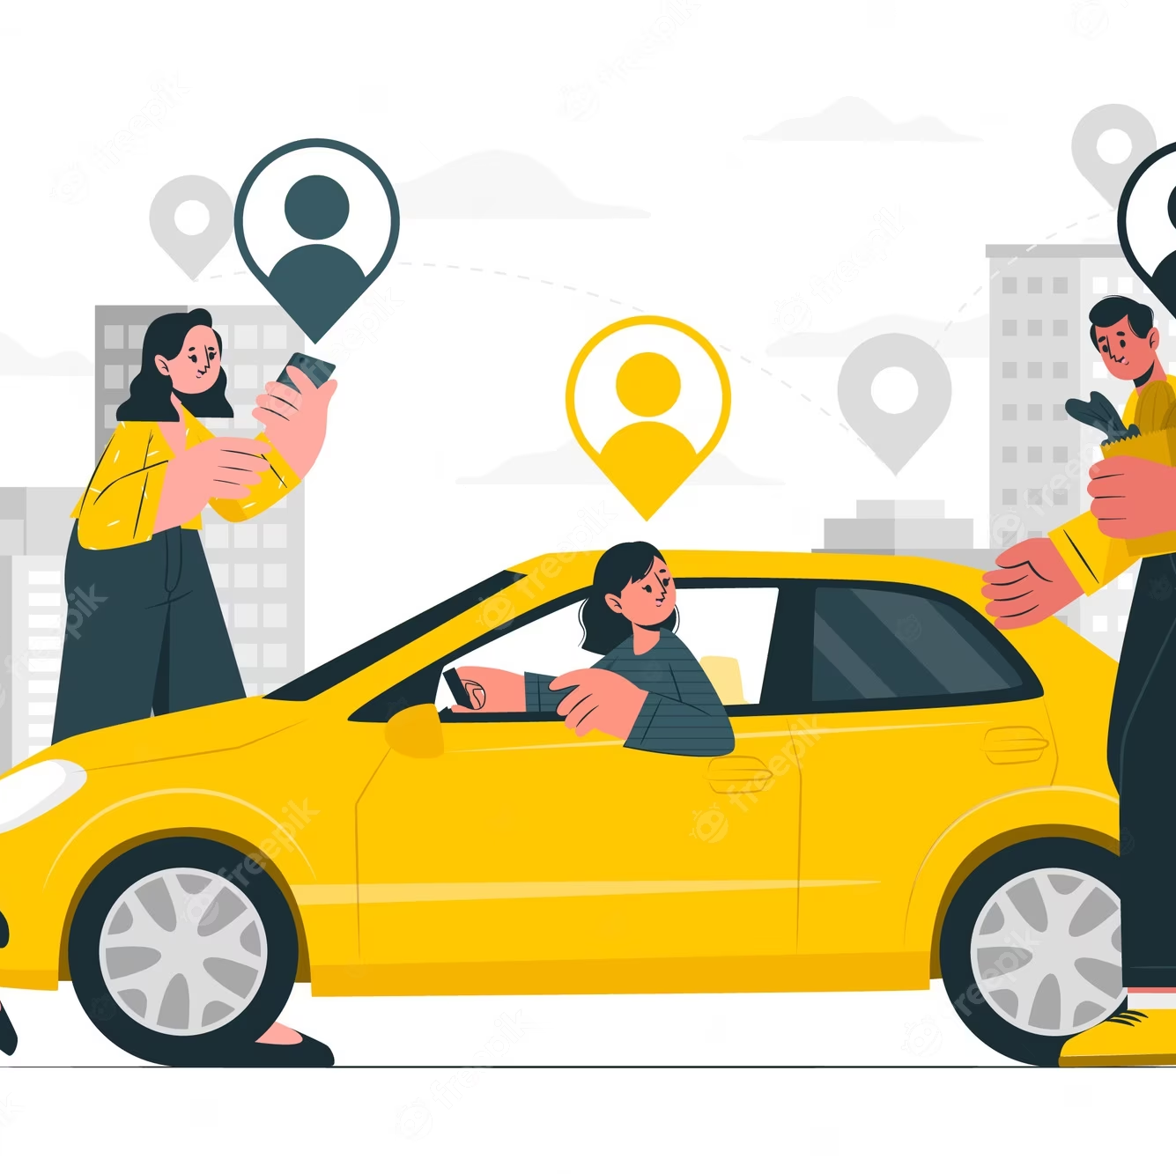
FCCU CARPOOL SERVICE FORMANRIDES
Group Members:
Afnan Ahmed
Hatib Zubair
Muhammad Muzammil
Project Advisors:
Akheem Yousaf (Primary Advisor)
Dr. Aasia Khanum (Secondary Advisor)

Slide 2
AGENDA
Introduction​
Problem Statement
Forman Rides Web Application
Technologies
Motivation
Live Demo
Application Flow
Conclusion
Future Work
Literature Review

Slide 3

Introduction
The practice of arranging for travel in a private vehicle driven by its owner, free or for a fee, especially by means of a website or application.
Ride sharing is increasing in developed nations due to everyday commute and many problems

Slide 4
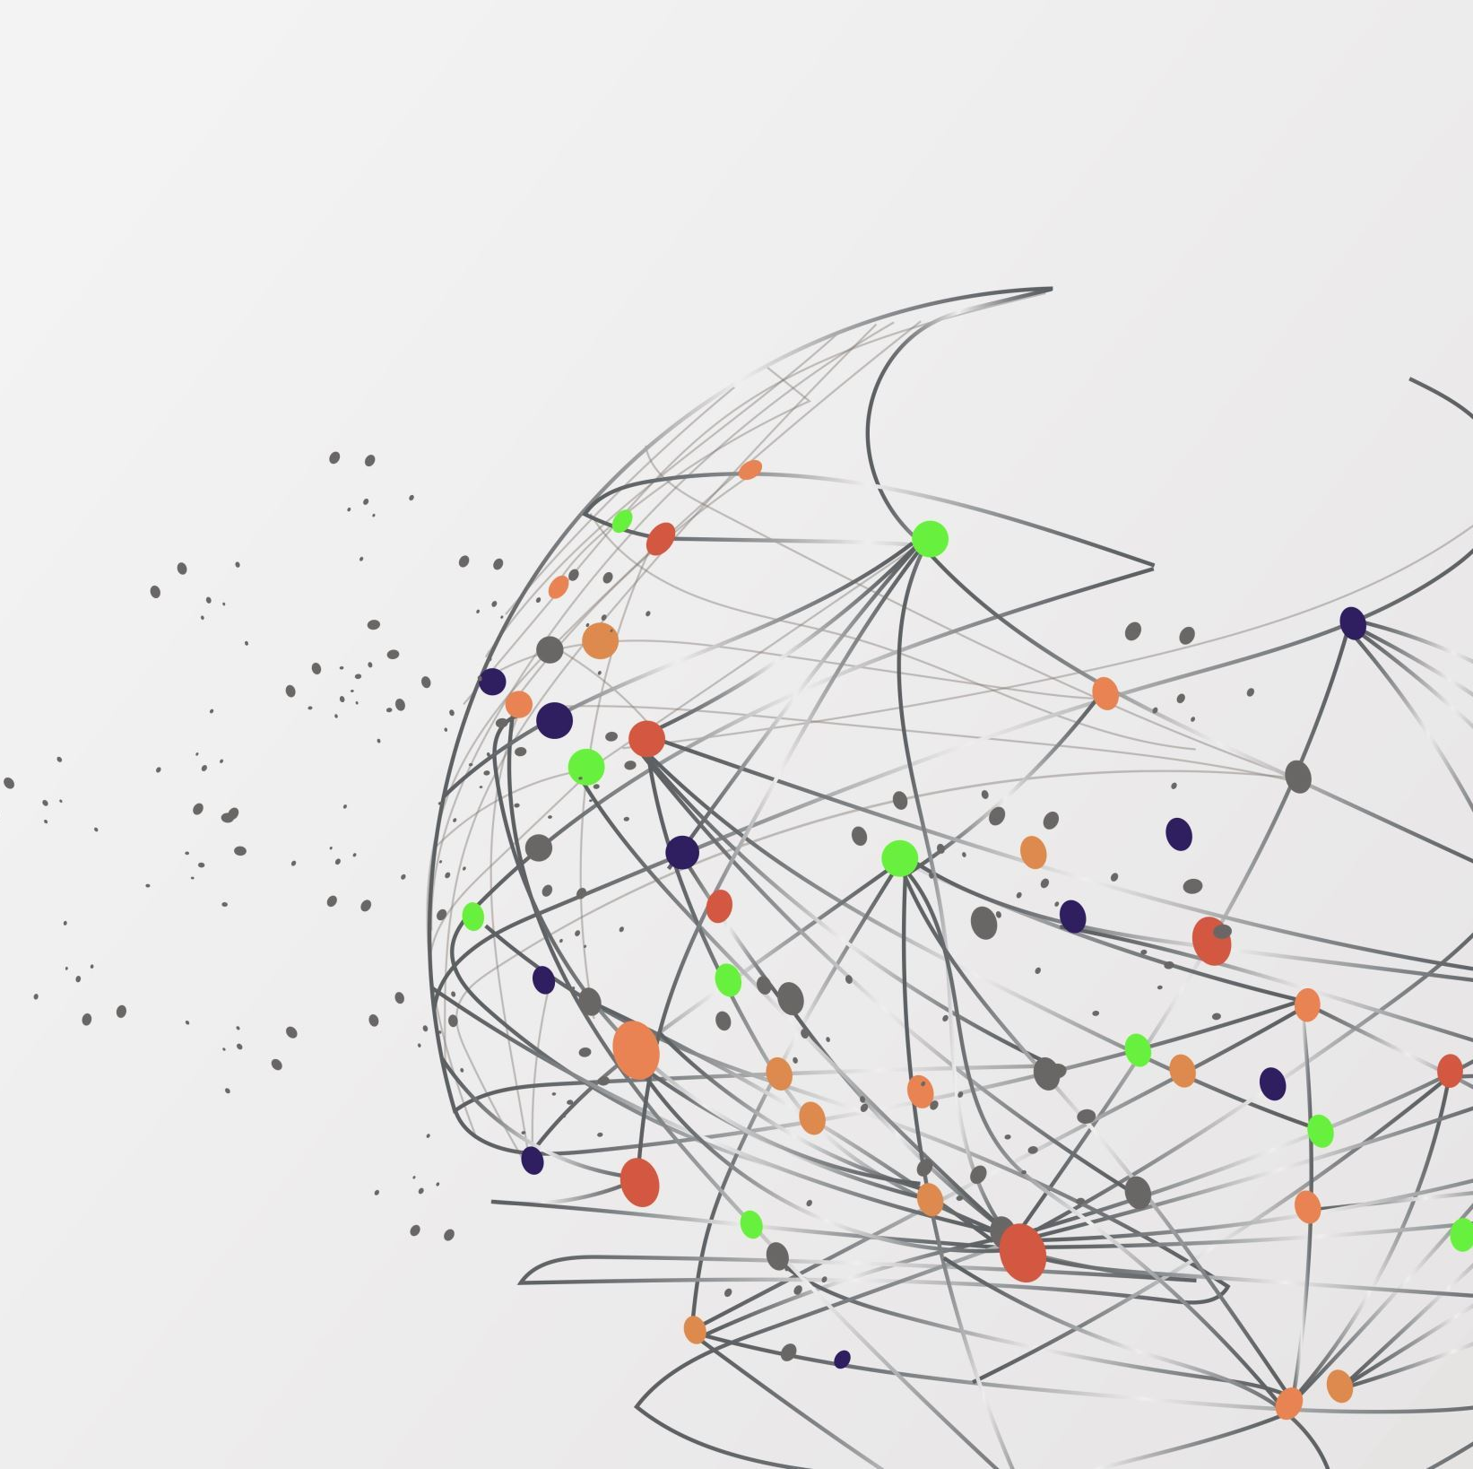
Problems:
Air Quality
High Fuel Costs
Traffic/Parking Blockage

Slide 5
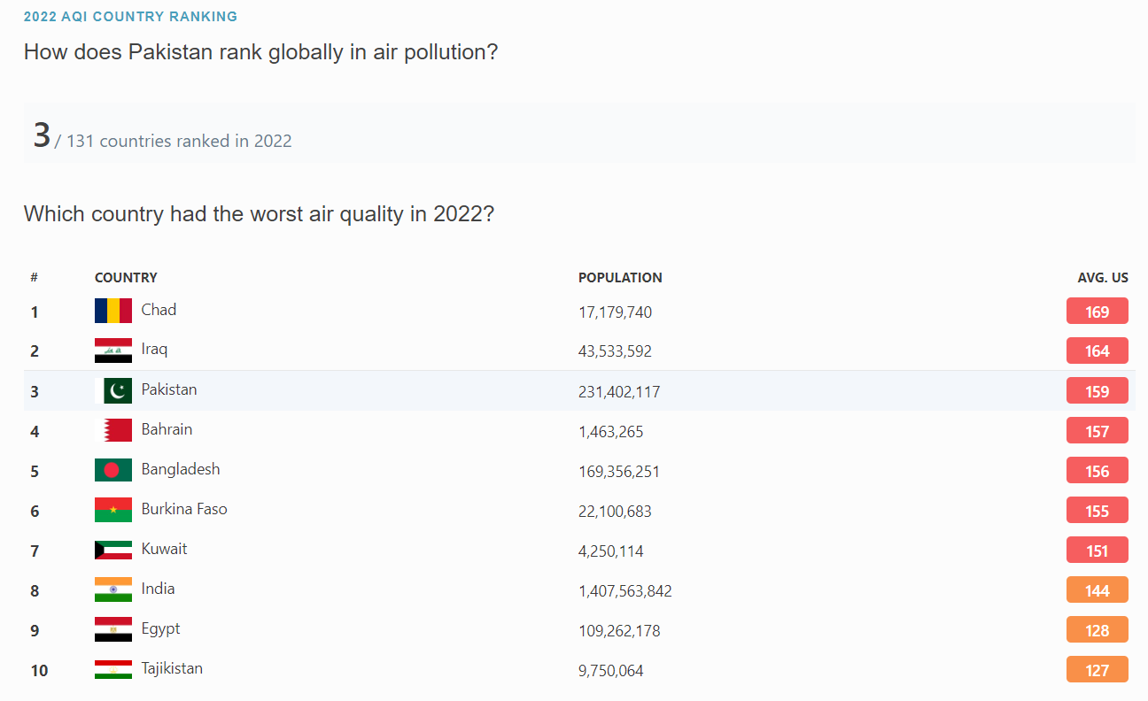
Air quality

Slide 6
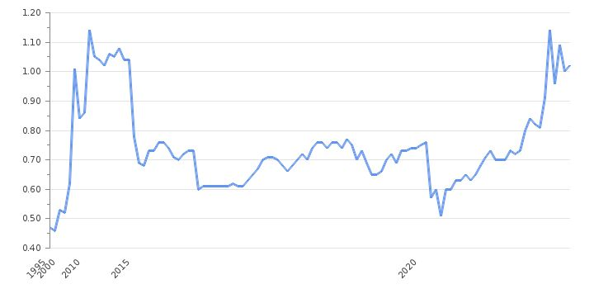
Fuel rates

Slide 7
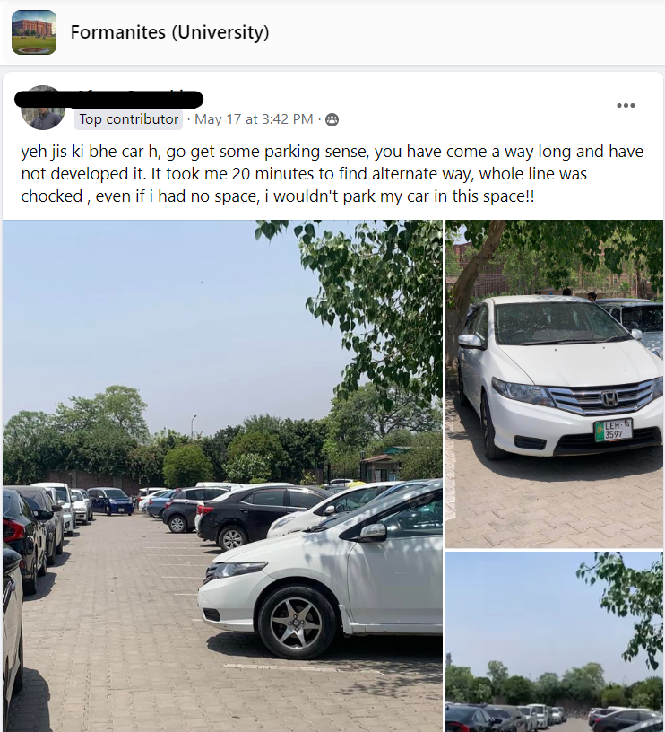
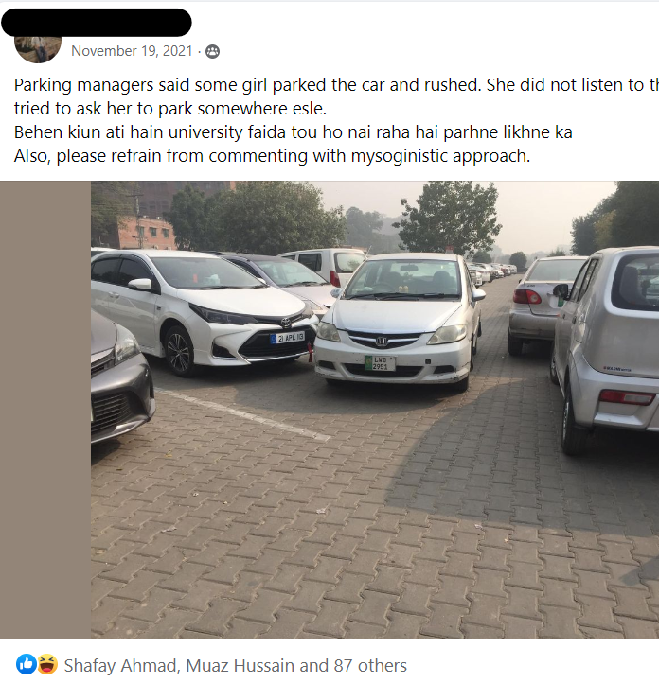
PARKING ISSUES IN FCCU

Slide 8

Literature Review
There are many carpooling applications all over the world. Uber, Careem and Ola are some if its examples
These applications provide the solution to high rates of single rides and help in adjusting with others so that it can be affordable for everyone.
CarPoolyn is a Pakistani app, which serves a similar purpose of ride sharing.
Different to bus rides
Interaction with university students.
Application is university-centric which saves time
Countering limited space

Slide 9
motivation
Easy commute for students to university
Reduce Traffic/Pollution so Air Quality gets better
Students don't have to worry about limited parking space

Slide 10
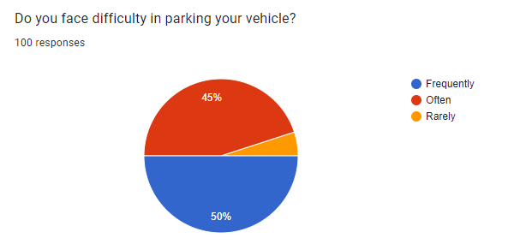
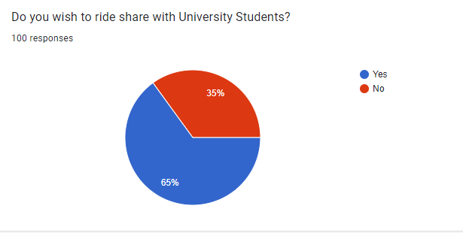
SURVEY RESULTS

Slide 11
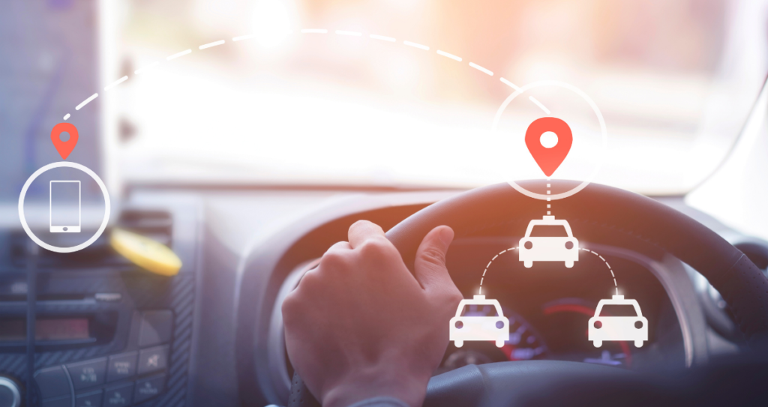
WHAT WE BUILT
A SIMPLE AND EASY TO USE RIDE SHARING WEB APPLICATION FOR STUDENTS OF FCCU

Slide 12





Technologies

Slide 13
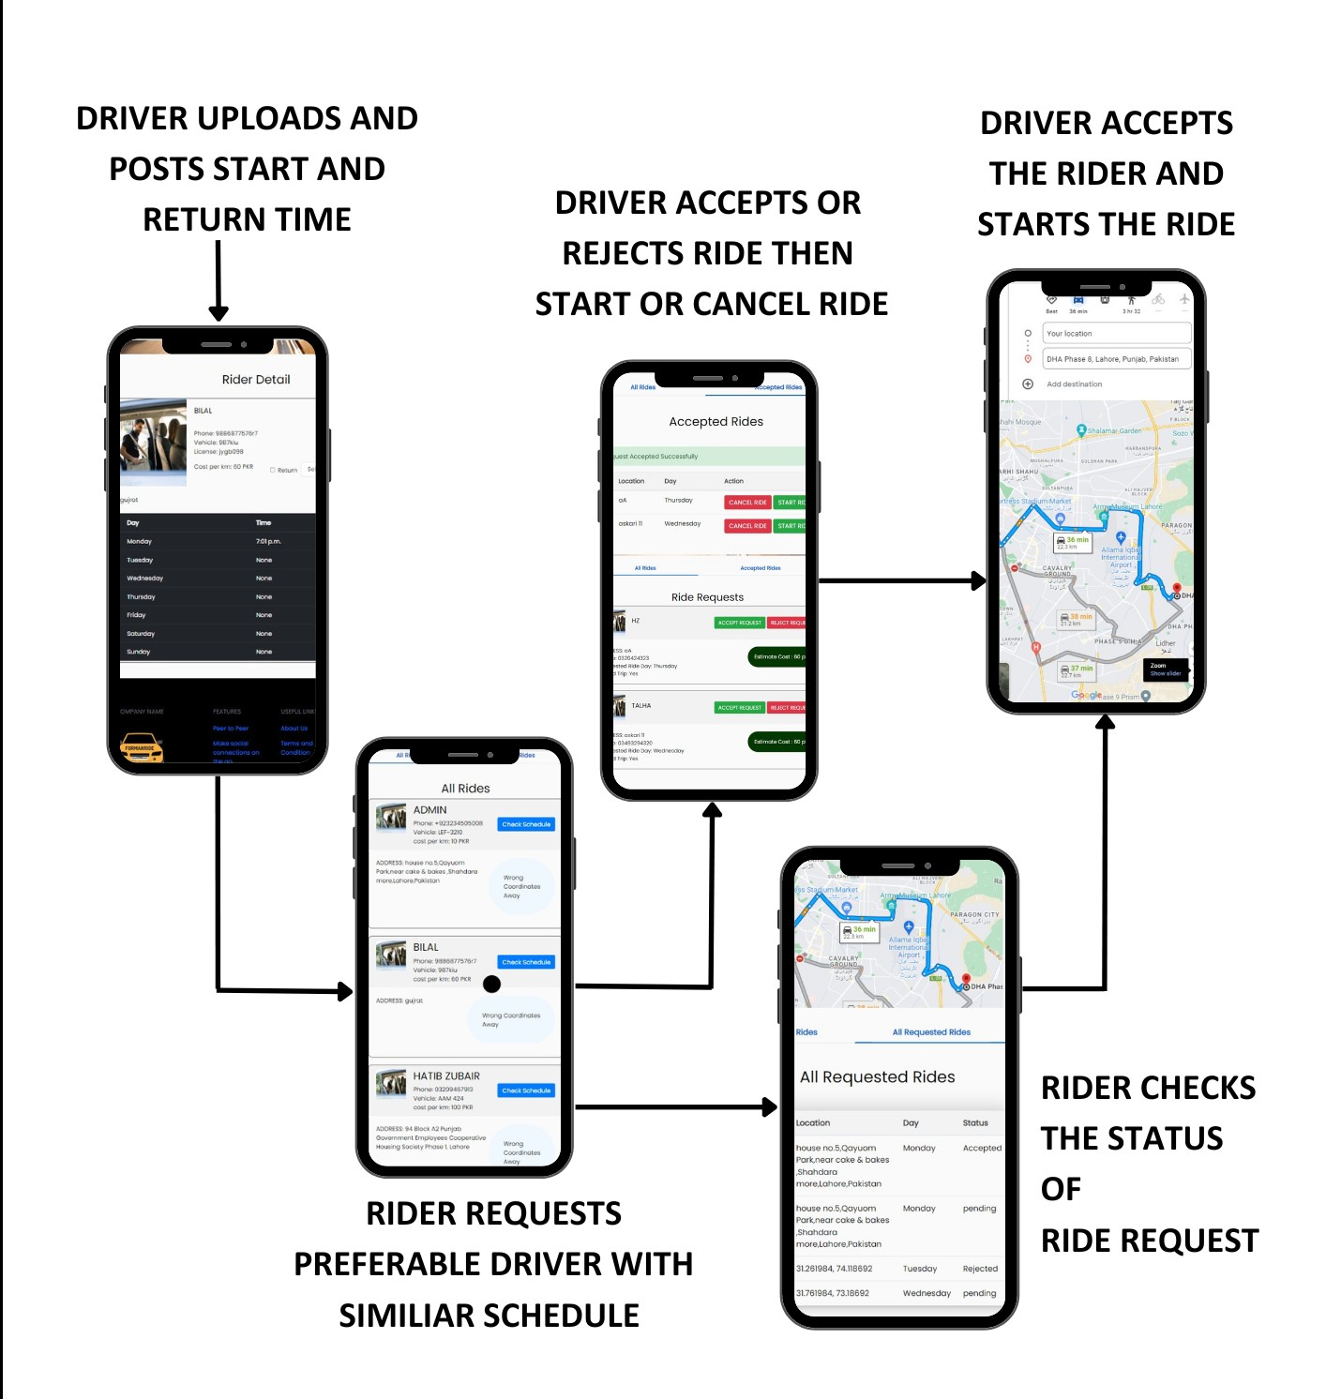
Application Flow

Slide 14
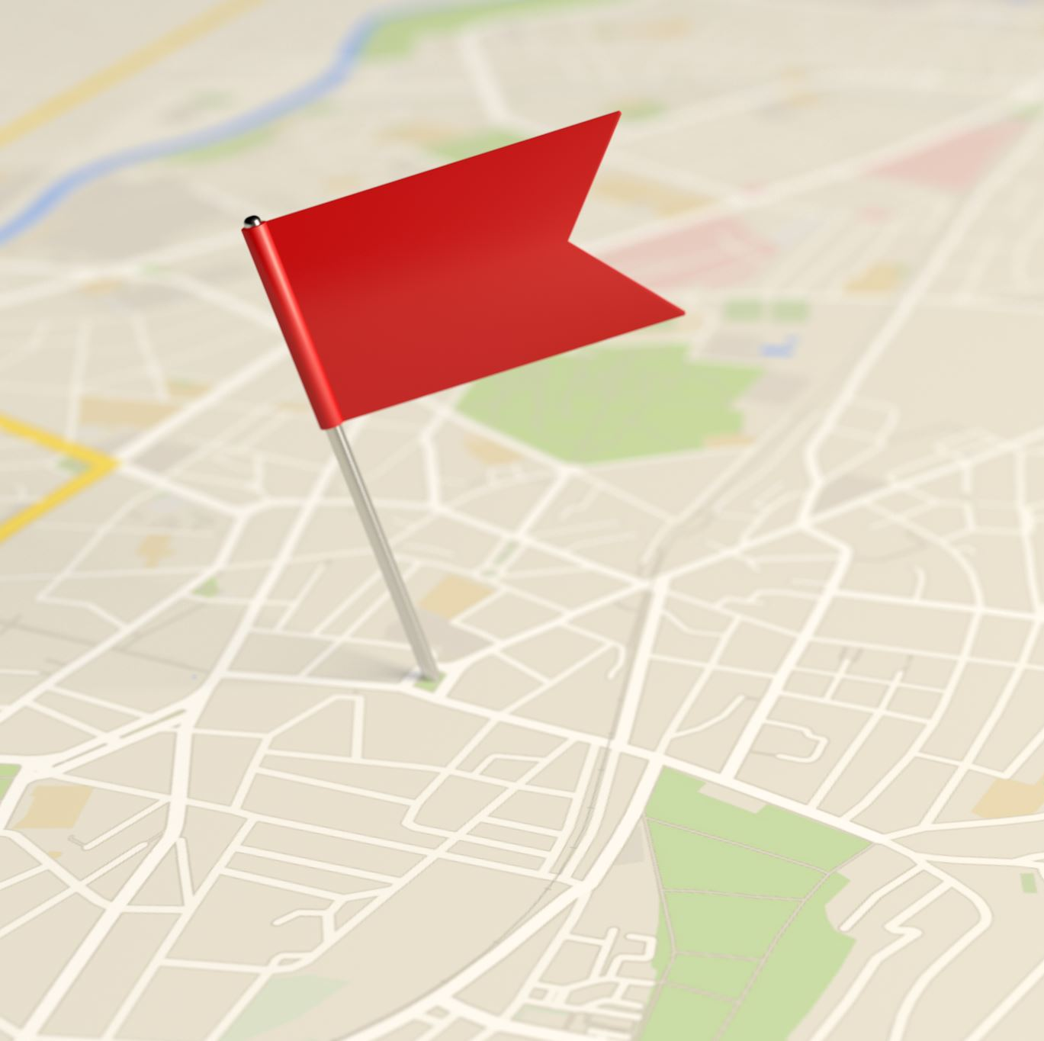
PROBLEMS FACED
Integrating Front-end and Backend
Getting Google Maps API in the application
Adding exact location of the user

Slide 15
Constraints
The application is university specific.
Many students will have different timings to come to university.
Students will be all over the city so could be difficult to find students in same area.
Males and females would not like to travel together because of the situation in the country.
A student could cancel the ride at the last minute which could affect other students as the fair would increase.

Slide 16
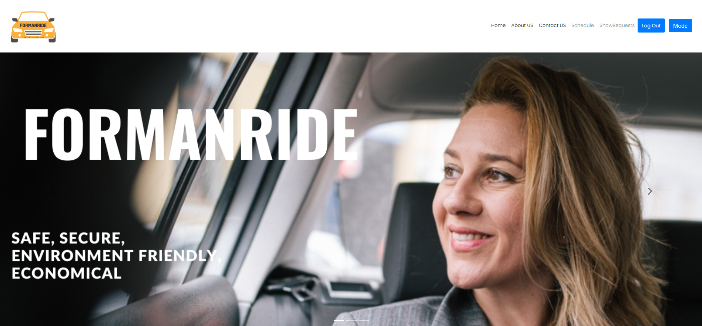
LIVE DEMO

Slide 17
FUTURE WORK
Deploy on iOS and Android
Add more checks on driver for security
Expand to other Universities
Add chat between rider and driver.
Integrate Google API within our application (When Users Increased)

Slide 18
Conclusion
Carpool Service for university Students
Help Students against rising inflation
Parking, a major issue in FCCU
Eco Friendly Travel
Effective

Slide 19
THANK YOU

